Slide 1
First Order Logic
Knowledge-based System Engineering
Intelligent Information Management Lab

Slide 2
Real World
Knowledge
Logical Representation
Reasoning
KBS

Slide 3
Recall: Propositional Logic
A proposition is a statement that is either True or False.
Examples:
  P = Student passed Programming Fundamentals;
  Q = Student passed Data Structures.
  R = Student can take Undergraduate Thesis
Rules can combine propositions with ¬, ∧, ∨, →, and ↔.
Question: how do we represent the same rule for 1,000 different students?
(P∧Q) → R

Slide 4
Why Propositional Logic is not enough?
Alice is a student.
Bob is a student.
Alice is taking the RSBP course.
Bob is taking the AI ​​course.
P = Alice is a student
Q = Bob is a student
R = Alice is taking KR
S = Bob is taking AI
However, it is difficult to state a general rule:
All students who take a course and meet the prerequisites are permitted to take that course.

Slide 5
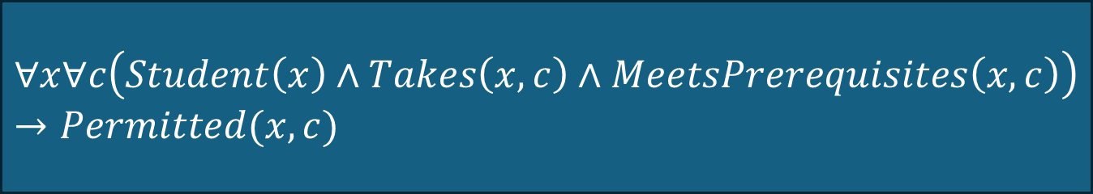
The Need for FOL
FOL lets us quantify over objects and state general rules.
It can represent individuals, properties, relationships, and general constraints.
Example: All students who take a course and meet the prerequisites are permitted to take that course.
$$∀x∀c\left(Student\left(x\right)∧Takes\left(x,c\right)∧MeetsPrerequisites\left(x,c\right)\right)→Permitted(x,c)$$

Slide 6
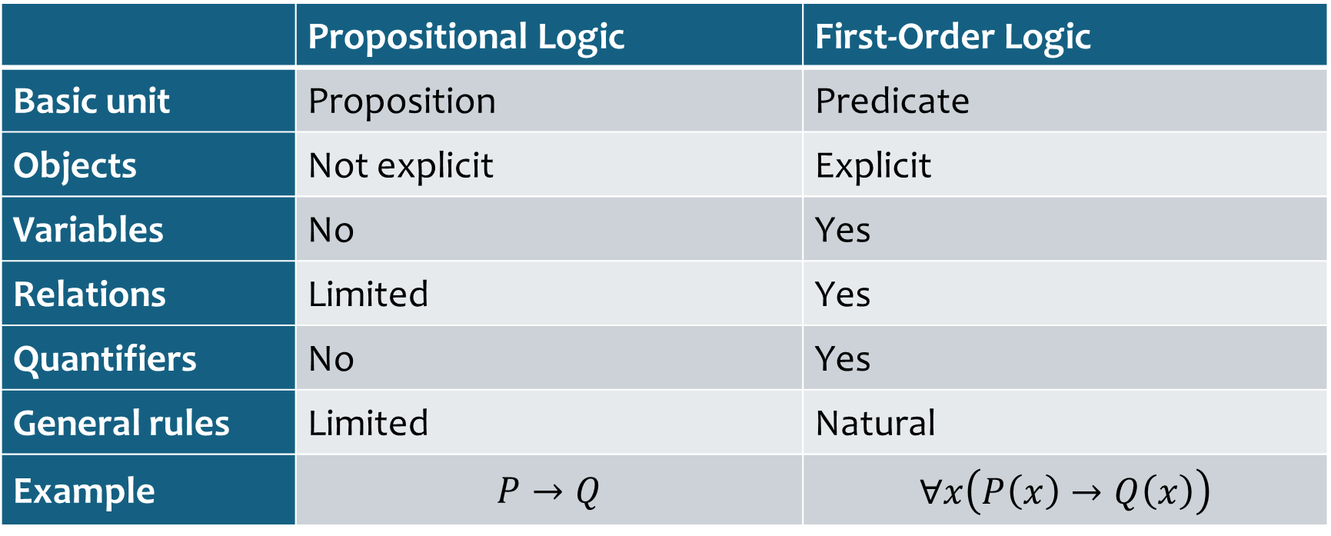
Propositional Logic vs FOL
 | Propositional Logic | First-Order Logic
Basic unit | Proposition | Predicate
Objects | Not explicit | Explicit
Variables | No | Yes
Relations | Limited | Yes
Quantifiers | No | Yes
General rules | Limited | Natural
Example | $$P→Q$$ | $$∀x\left(P\left(x\right)→Q\left(x\right)\right)$$

Slide 7
Why FOL in Knowledge Representation?
• Represent objects explicitly.
• Represent properties of objects.
• Represent relationships between objects.
• Represent general rules that apply to many objects.
• Ask queries about particular individuals or relationships.

Slide 8
Anatomy of FOL
Example:
Student(Ani): Student is a predicate; Ani is a constant.
Enrolled(Ani, DataMining): Enrolled is a binary predicate relating two objects.
∀x Student(x) → Human(x): x is a variable quantified over the domain.

Slide 9
Constants
• A constant refers to a particular object in the domain.
• Examples: Ani, Budi, DataMining, ITS, Room101.
• Student(Ani) states that the individual named Ani is a student.

Slide 10
Variables
• Variables stand for arbitrary objects.
• Common notation: x, y, z.
• Student(x)means: x is a student; it becomes a concrete statement when x is instantiated.

Slide 11
Predicates
Predicates represent properties or relations.
Types of predicates:
  Unary: Student(x)
  Binary: Enrolled(x,y).
  Ternary: Teaches(x,y,z).
Example:
Teaches(Budi,DataMining,Room101)
Meaning: Lecturer Budi teaches Data Mining in Room 101.
Unary commonly used to represent property, Binary and Ternary commonly used to represent relations

Slide 12
Functions
• A function maps one or more objects to an object.
• Example: AdvisorOf(Ani) can denote Ani's advisor.
• Compare MotherOf(Ani) with Mother(Ani,Budi): the first is a term; the second is a relation.

Slide 13
Terms
• A term can be a constant, a variable, or a function expression.
• Examples: Ani; x; AdvisorOf(Ani).
• Terms denote objects rather than truth values.

Slide 14
Atomic Formula
• An atomic formula is a predicate applied to the appropriate number of terms.
• Examples:
  Student(Ani)
  Enrolled(Ani,DataMining)
  Prerequisite(DataMining,Database).
• Atomic formulas are evaluated as true or false under an interpretation.

Slide 15
Logical Connectives
Operator | Meaning
¬ | NOT
∧ | AND
∨ | OR
→ | IF...THEN
↔ | IF AND ONLY IF
Example:
Student(x)∧ Enrolled(x,DataMining)

Slide 16
Quantifiers
Quantifiers | Meaning | Example
∀ | for all / every | ∀xStudent(x)→Human(x) Meaning: Every student is a human
∃ | there exists / at least one | ∃xStudent(x)∧Excellent(x) Meaning: There is at least one excellent student.

Slide 17
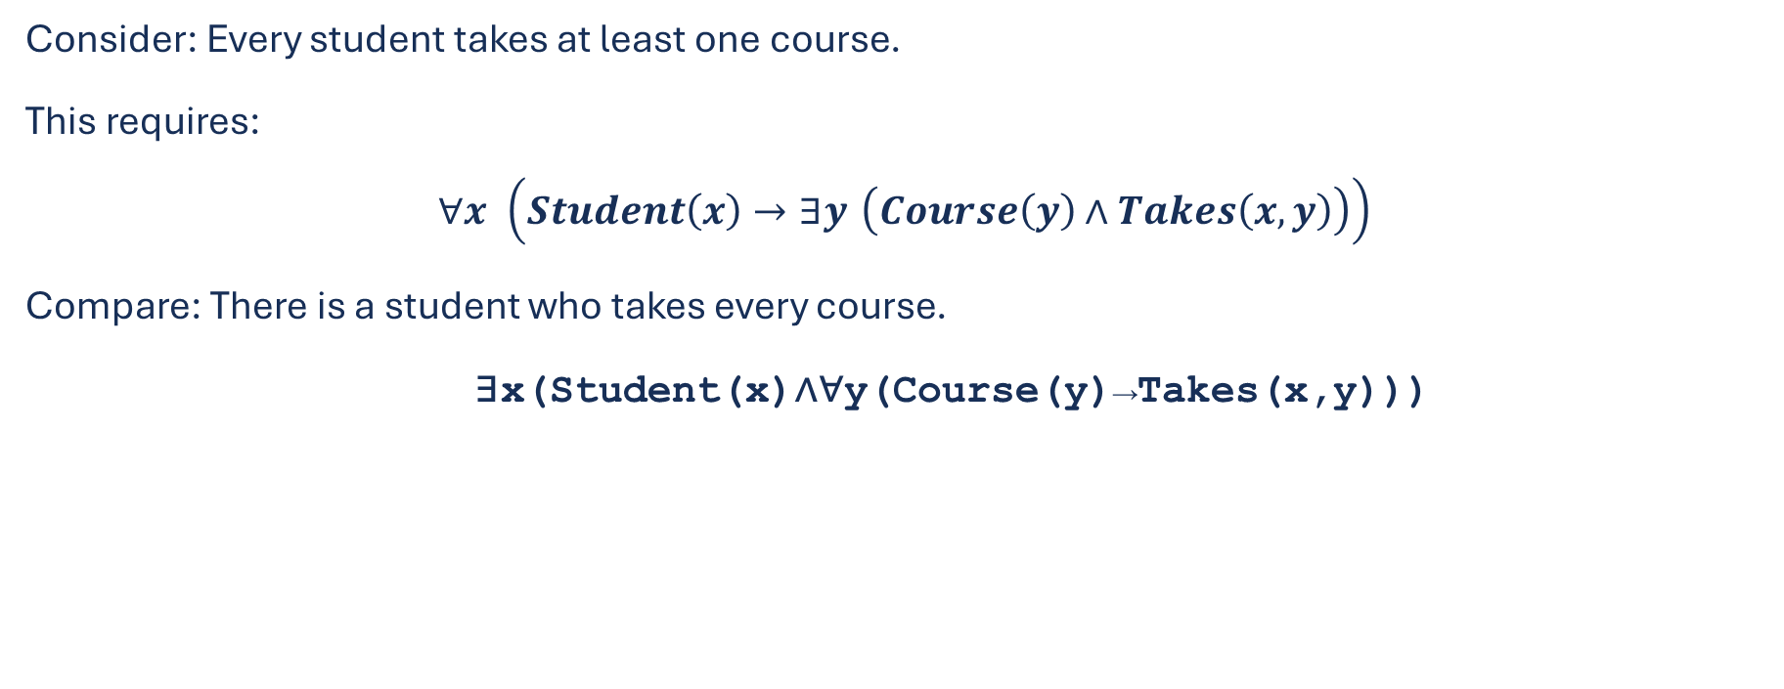
Universal vs Existential
Consider: Every student takes at least one course.
This requires:
$$∀x \left(Student\left(x\right)→∃y \left(Course\left(y\right)∧Takes\left(x , y\right)\right)\right)$$
Compare: There is a student who takes every course.
∃x(Student(x)∧∀y(Course(y)→Takes(x,y)))
Important: The order of quantifiers matters.

Slide 18




Scope, Free Variable, and Bound Variable
$$Student\left(x\right)→Takes(x,KBSE)$$
$x$ is free variable.
$$∀x(Student\left(x\right)→Takes(x,KBSE))$$
$x$ is bound variable.
Example scope:
$$∀x(Student\left(x\right)→∃y(Course\left(y\right)∧Takes(x,y)))$$
Meaning: Each student takes at least one course.
The order of quantifiers changes the meaning!
$$∃y(Course\left(y\right)∧∀x(Student\left(x\right)→Takes(x,y)))$$
Meaning: There is a specific course taken by all students.

Slide 19
Classroom Activity
1. Every student is enrolled in a course.
2. Some student is enrolled in Data Mining.
3. Every lecturer teaches at least one course.
4. There is a course that every student takes.
Write the FOL formula and explain the quantifier scope.

Slide 20
Case Study 1: Academic Advising
Question:
  Can student Ani take Data Mining?
Suppose the academic policy says:
A student must pass Database.
A student must pass Programming.
A student must satisfy the credit requirement.
A student must have no academic hold.

Slide 21
Case Study 1: Representing the Entities
Student achievements (Knowledge base):
  Passed(Ani,Database)
  Passed(Ani,Programming)
  HasCredits(Ani,24)
  NoHold(Ani)

Slide 22
Case Study 1: Representing Relationships
Prerequisites:
Prerequisite(DataMining,Database)
Prerequisite(DataMining,Programming)
Enrollment:
Enrolled(Ani,DataMining)

Slide 23
Case Study 1: General Rules
General rule: If a student passes all prerequisites and satisfies academic requirements, then the student is eligible.
Representation:
∀x Student(x) ∧ Passed(x,Database) ∧ Passed(x,Programming) ∧ HasCredits(x,24) ∧ NoHold(x) → Eligible(x,DataMining)

Slide 24
Case Study 1: Query
Query:
Eligible(Ani,DataMining)?
Rule:
∀xConditions(x)→Eligible(x,DataMining)
Expected conclusion:
KB⊨Eligible(Ani,DataMining)

Slide 25
Tutorial 1: SWI-Prolog

Slide 26
Steps
Open SWI-Prolog or SWISH online: https://swish.swi-prolog.org/
Create a program
Enter facts and rules.
Run a query using `?-`.
Interpret the answer (true/false or variable bindings).
Facts + Rules + Query → Answer

Slide 27
Prolog: Facts and Rules
student(alice).
student(bob).
passed(alice, sbd).
passed(bob, sbd).
gpa_min_3(alice).
may_take(X, mbd) :-
student(X),
passed(X, sbd),
gpa_min_3(X).

Slide 28
Prolog: Query dan Jawaban
</> prolog
?- may_take(alice, mbd).
true.
Alice meets all the requirements.
</> prolog
?- may_take(bob, mbd).
false.
It is not yet known whether Bob has a GPA ≥ 3.
</> prolog
?- may_take(X, mbd).
X = alice.
A query with variables returns bindings.
Discussion: In Prolog, “false” often means that something cannot be proven from the knowledge base, rather than necessarily being false in classical FOL.

Slide 29
Assignment
Choose one domain:
Hospital/patient management
Library management
E-commerce
Transportation
Agriculture
Etc..s

Slide 30
Assignment
Deliverables:
1. Domain model
Identify: entities, attributes, relationships, and rules
2. FOL representation
At least: 10 facts, 5 general rules, 3 queries
3. Reasoning
For each query, state the facts and rules, then derive the conclusion
Analysis: why it can/cannot be inferred, is there possible contradiction
4. Try in prolog

Slide 31
Thank you

